Slide 1


PROJECT & PROFESSIONALISM
MID – REVIEW
Ravichandran Abilash - 2222737

Slide 2
Developing a Learning Management System for the IT Students
Project Title.

Slide 3
Table of Content
Introduction
Data and Methods
Methods and Techniques
Project progress – project time line
Project progress – project current status
Project progress – project test case
Project progress – project prototype screen shots
Tools
Reference

Slide 4
Introduction
Academic Question
How to develop the interactive web-based system for managing a learning activity?
Aims and Objectives
Aim is to develop a interactive web learning management system for the IT students for the better study environment.
First need to find what are the thing need to implement in the learning management system.
Identify the target audience and get their opinion for add elements to the system.
Research about the similar system that are already available in the internet to know the pros & cons.
Planning to implement the learning management system more user friendly compare to the other platform are available in the internet.

Slide 5
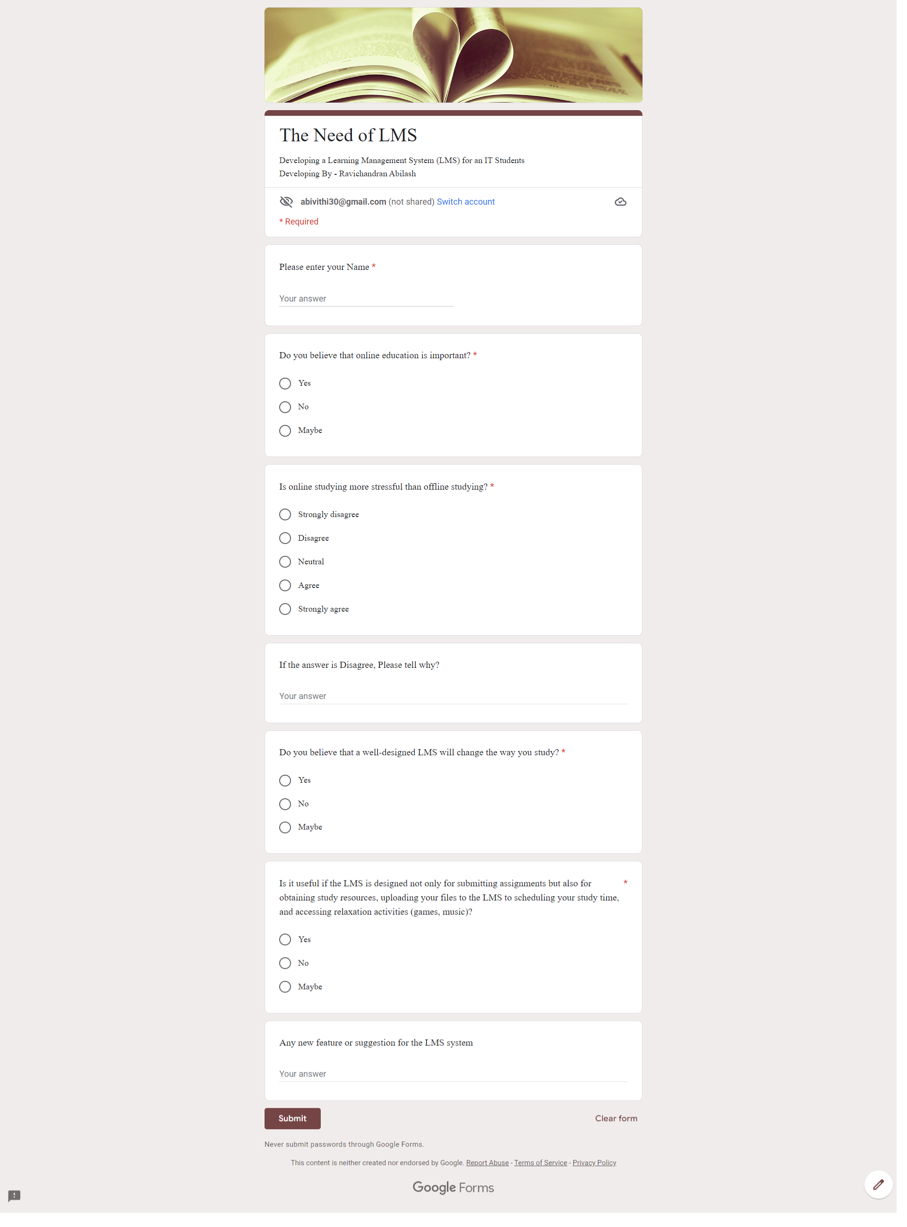
Data and Methods
Introduction of the data used
Primary data
For the primary data collection I took the survey from several students using google forms in the below I added the figures of the survey

Slide 6
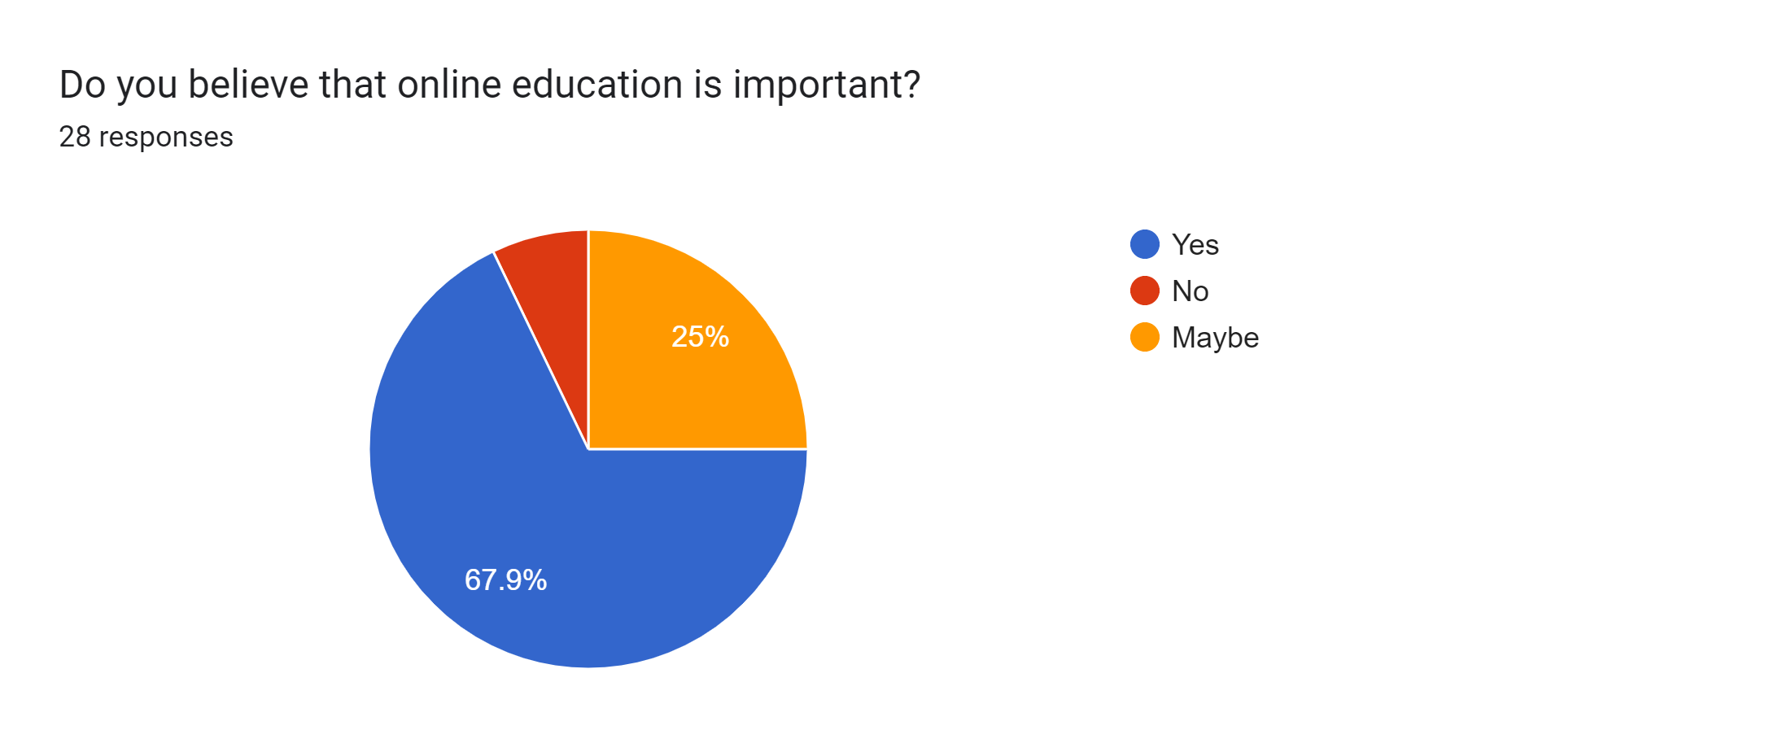
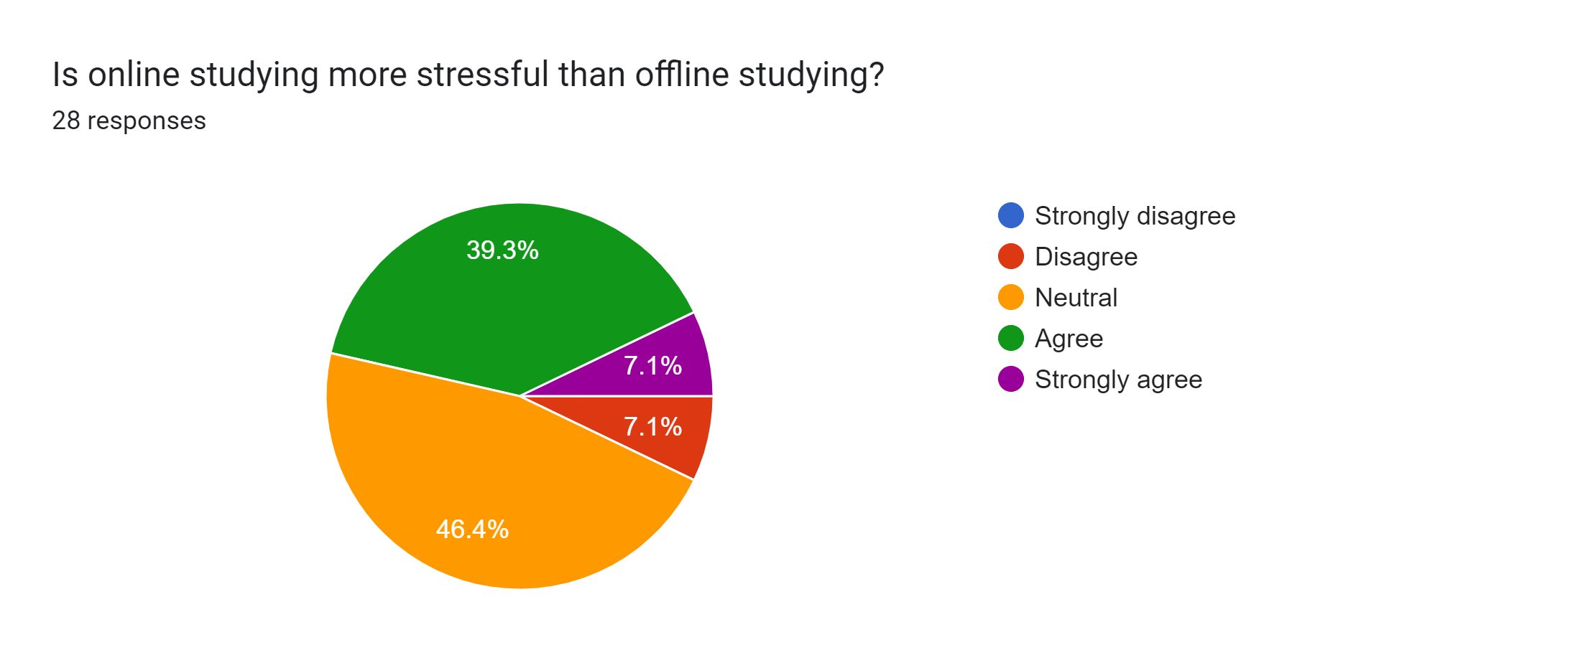
Data and Methods
Introduction of the data used
Primary data
Survey Results

Slide 7
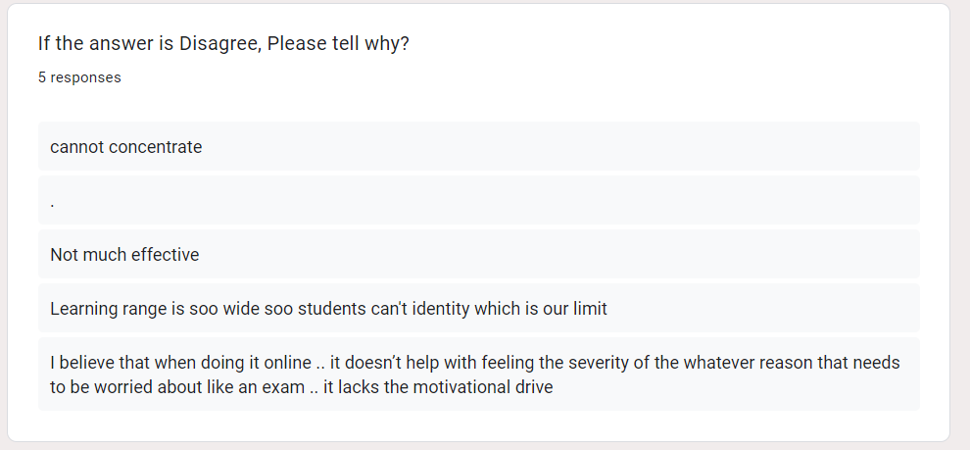
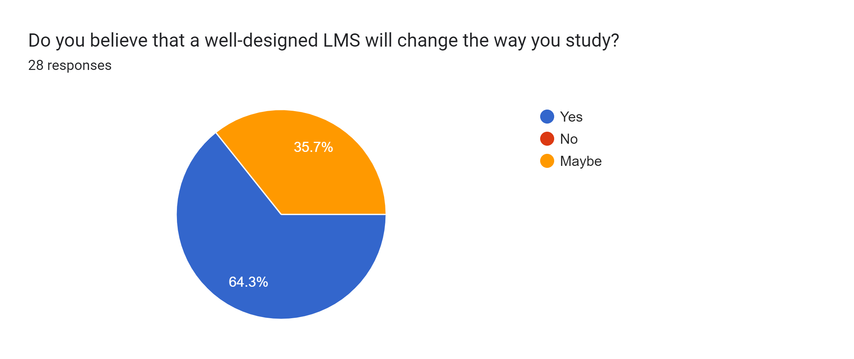
Data and Methods
Introduction of the data used
Primary data
Survey Results Cont.

Slide 8
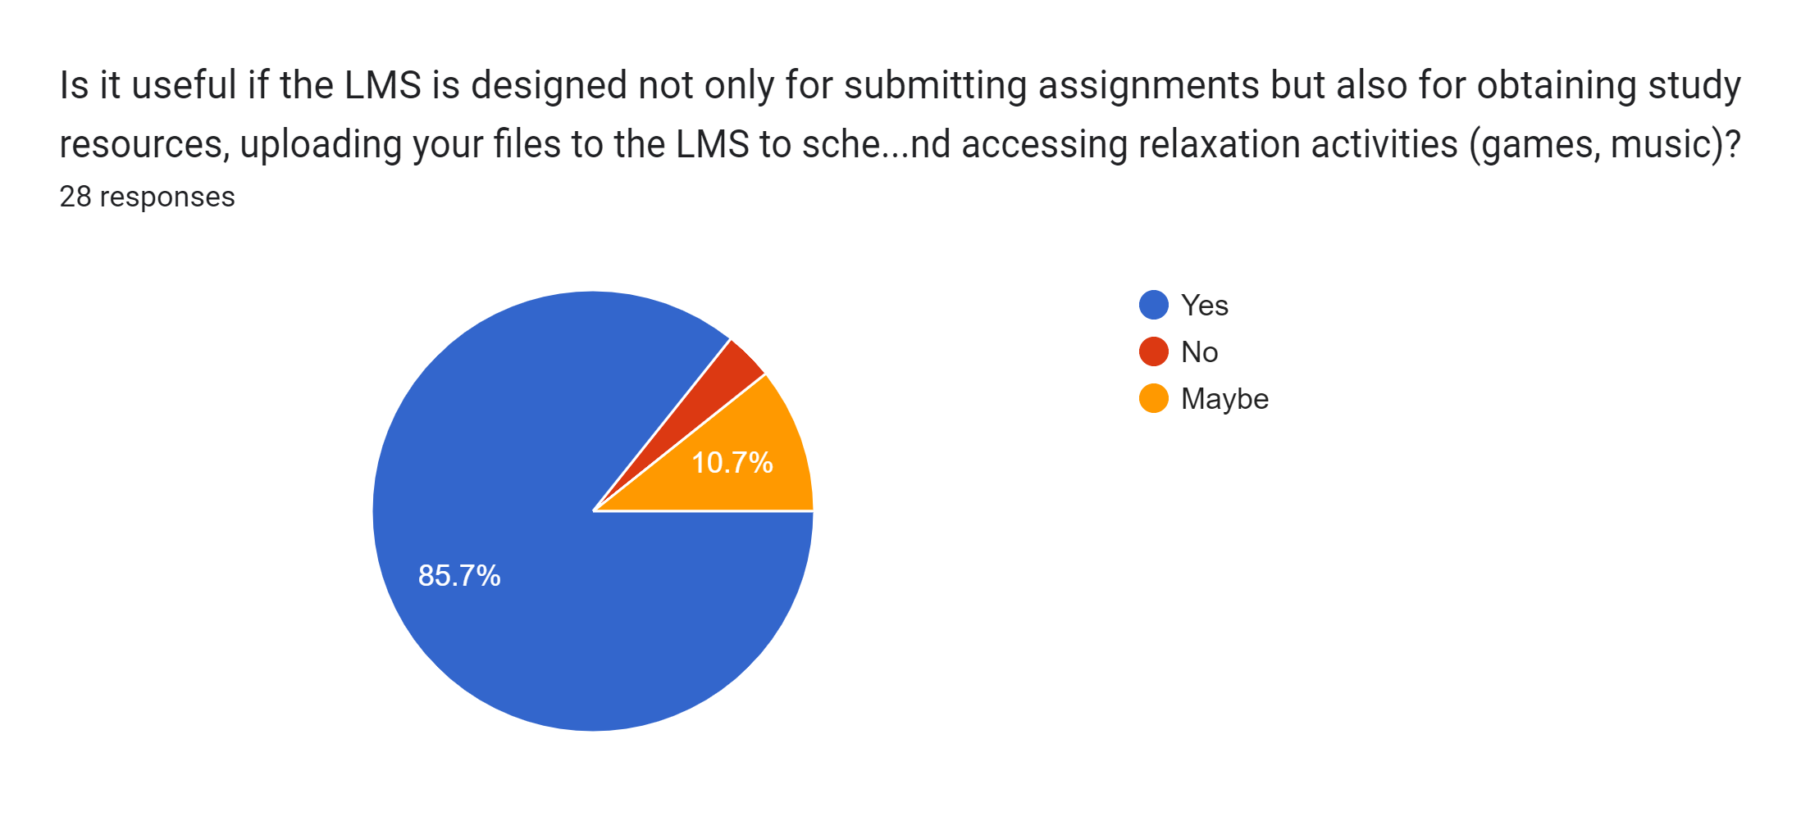
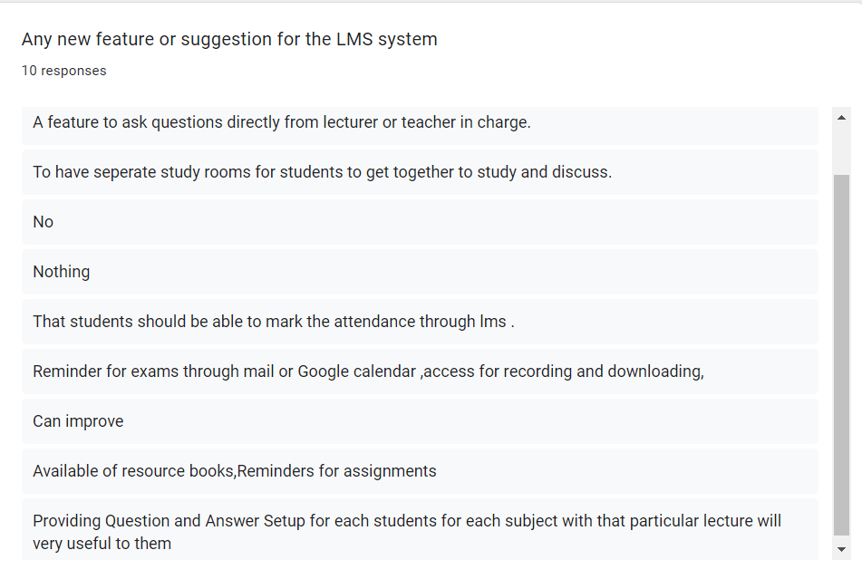
Data and Methods
Introduction of the data used
Primary data
Survey Results Cont.

Slide 9
Data and Methods
Secondary Data
Sujit kumar basak, marguerite wotto and paul bélanger. 2018. E-Learning and Digital Media. 4th July. E-learning, M-learning and D-learning:. [Online]. [14 March 2022]. Available from: https://journals.sagepub.com/doi/full/10.1177/2042753018785180
Ammar y alqahtani and albraa a rajkhan. 2020. E-Learning Critical Success Factors during the COVID-19 Pandemic: A Comprehensive Analysis of E-Learning Managerial Perspectives. 20th August. [Online]. [14 March 2022]. Available from: https://www.mdpi.com/2227-7102/10/9/216/htm
Jesús valverde-berrocoso, maría del carmen garrido-arroyo, carmen burgos-videla and maría belén morales-cevallos. 2020. Trends in Educational Research about e-Learning: A Systematic Literature Review (2009–2018). 22nd June. [Online]. [14 March 2022]. Available from: https://www.mdpi.com/2071-1050/12/12/5153/htm
Diane o’doherty, marie dromey, justan lougheed, ailish hannigan, jason last & deirdre mcgrath . 2018. Barriers and solutions to online learning in medical education – an integrative review. 7th June.[Online]. [14 March 2022]. Available from: https://bmcmededuc.biomedcentral.com/articles/10.1186/s12909-018-1240-0#citeas
Mohammed amin almaiah, ahmad al-khasawneh & ahmad althunibat . 2020. Exploring the critical challenges and factors influencing the E-learning system usage during COVID-19 pandemic. 22nd May. [Online]. [14 March 2022]. Available from: https://link.springer.com/article/10.1007/s10639-020-10219-y

Slide 10
Data and Methods
Secondary Data Cont.
Carmen carrillo &maria assunção flores. 2020. COVID-19 and teacher education: a literature review of online teaching and learning practices. 13th September. [Online]. [14 March 2022]. Available from: https://www.tandfonline.com/doi/full/10.1080/02619768.2020.1821184
Long pham, yam b limbu, trung k bui, hien t nguyen & huong t pham . 2019. Does e-learning service quality influence e-learning student satisfaction and loyalty? Evidence from Vietnam. 08th March. [Online]. [14 March 2022]. Available from: https://link.springer.com/article/10.1186/s41239-019-0136-3
vandana singh &alexander thurman. 2019. How Many Ways Can We Define Online Learning? A Systematic Literature Review of Definitions of Online Learning (1988-2018). 01st Oct. [Online]. [14 March 2022]. Available from: tandfonline.com/doi/full/10.1080/08923647.2019.1663082?scroll=top&needAccess=true
Nabil m hasasneh, mohammad m moreb. 2013. E-learning at Hebron University -- A Case Study. [Online]. [17 March 2022]. Available from: https://ieeexplore.ieee.org/stamp/stamp.jsp?tp=&arnumber=6745581
Mozhdeh dokhani, babak majidi, ali movaghar . 2019. Visually Enhanced E-learning Environments Using Deep Cross-Medium Matching . [Online]. [17 March 2022]. Available from: https://ieeexplore.ieee.org/stamp/stamp.jsp?tp=&arnumber=9091669

Slide 11
Data and Methods
Secondary Data Cont.
Samani ahmed . 2013. The Role of e-Learning to Face the Challenges of the Century . [Online]. [18 March 2022]. Available from: https://ieeexplore.ieee.org/stamp/stamp.jsp?tp=&arnumber=6745557
Yanti tjong, lianna sugandi, alifah nurshafita, yulia magdalena, clara evelyn, novita sari yosieto. 2018. User Satisfaction Factors on Learning Management Systems Usage . [Online]. [18 March 2022]. Available from: https://ieeexplore.ieee.org/stamp/stamp.jsp?tp=&arnumber=8528171
Mir mohammad seyed danesh. 2010. Comparing the satisfaction of the e-learning between teenagers and people with more than 45 years old in Cyberjaya. [Online]. [20 March 2022]. Available from: https://ieeexplore.ieee.org/stamp/stamp.jsp?tp=&arnumber=5432502
Xiaofei chen,xiaoling zhu . 2010. Some Analysis of Investment Benefit on College E-Learning. [Online]. [20 March 2022]. Available from: https://ieeexplore.ieee.org/stamp/stamp.jsp?tp=&arnumber=5432483
Blanka klimova, petra maresova. 2016. Cloud Computing and E-Learning and Their Benefits for the Institutions of Higher Learning. [Online]. [20 March 2022]. Available from: https://ieeexplore.ieee.org/stamp/stamp.jsp?tp=&arnumber=8009043

Slide 12
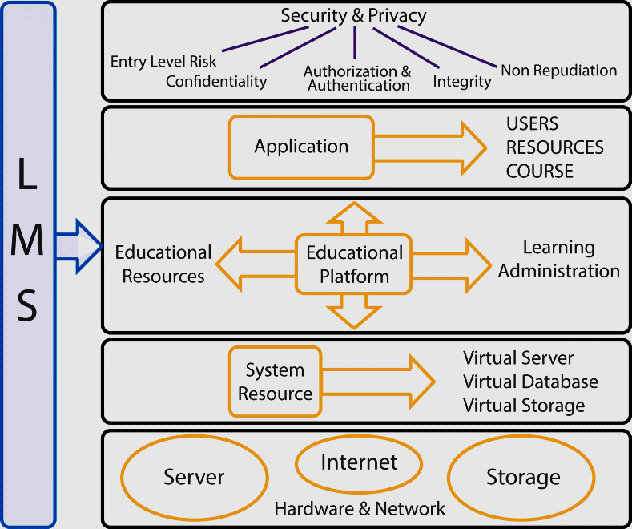
Methods and Techniques
Architectural Diagram

Slide 13
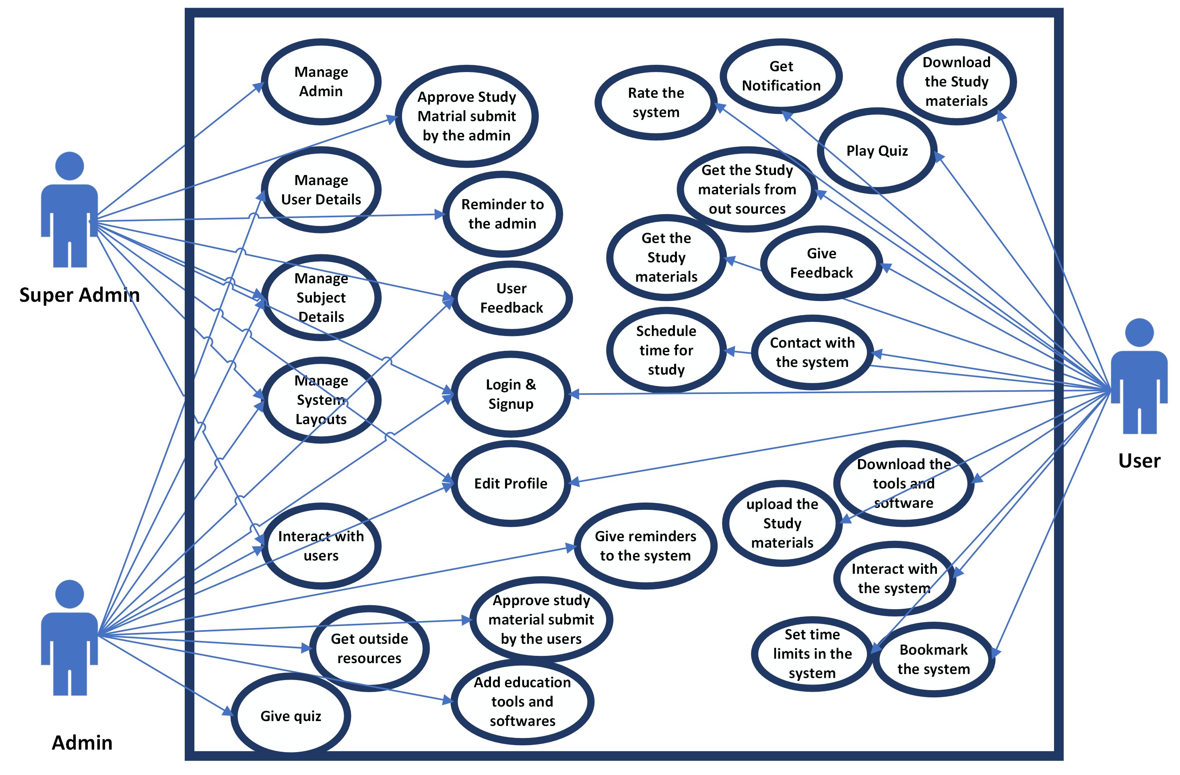
Methods and Techniques
Use case Diagram

Slide 14
Project Progress – Project Timeline
No | Milestones | Start Date | End Date
1 | Identifying the project title | 20/02/2022 | 19/03/2022
2 | Reading Research papers & Supervisor assigning | 19/03/2022 | 24/04/2022
3 | Proposal Submission | 25/04/2022 | 28/04/2022
4 | Plan System Structure and Assignment Feedback | 29/04/2022 | 15/05/2022
5 | Starting to develop the application & Supervisor meetings | 16/05/2022 | 02/07/2022

Slide 15
Project Progress – Project Timeline Cont.
No | Milestones | Start Date | End Date
6 | Mid Review & Professional Assessment | 03/07/2022 | 07/07/2022
7 | Develop the balance application with suggestion of the supervisor | 08/07/2022 | 31/08/2022
8 | Develop the application and submit Draft Report | 01/09/2022 | 04/09/2022
9 | Testing the System | 04/09/2022 | 02/10/2022
10 | Final Report submission and viva | 02/10/2022 | 16/10/2022

Slide 16
Project Progress – Current Status
Professional Assessment – Completed
Final Project Documentation – Chapter 01 and 02 are Completed
Learning Management System Frontend – Admin, Lecturer, Home Design are Completed
Learning Management System Backend – Admin & Lecturer Functions are created

Slide 17
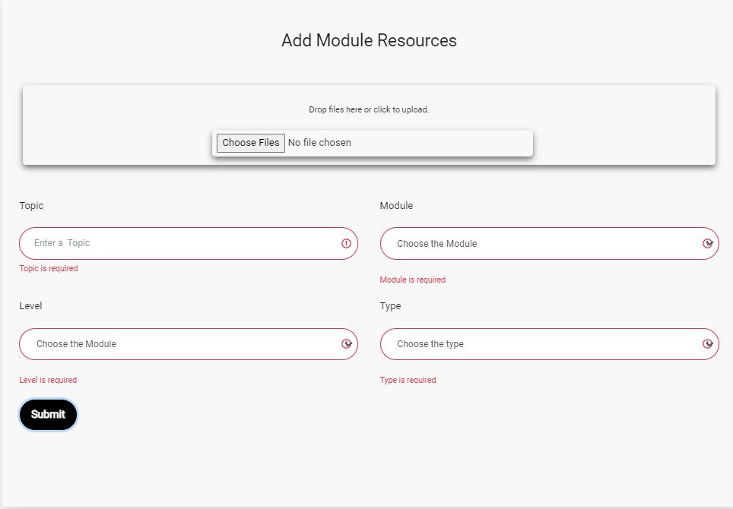
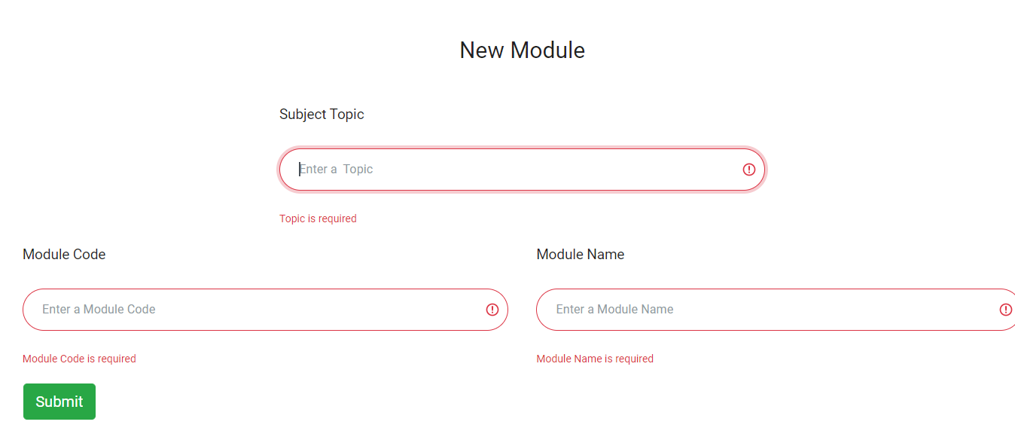
Project Progress – Test Case
Test Case | Description | Expected Result
01 | While fill the New module form if user did not fill the particular text box. | The form validation should give a error message
Test Case | Description | Expected Result
02 | While fill the Module Resources form if user did not fill the particular text box. | The form validation should give a error message
Output Result - Pass
Output Result - Pass

Slide 18
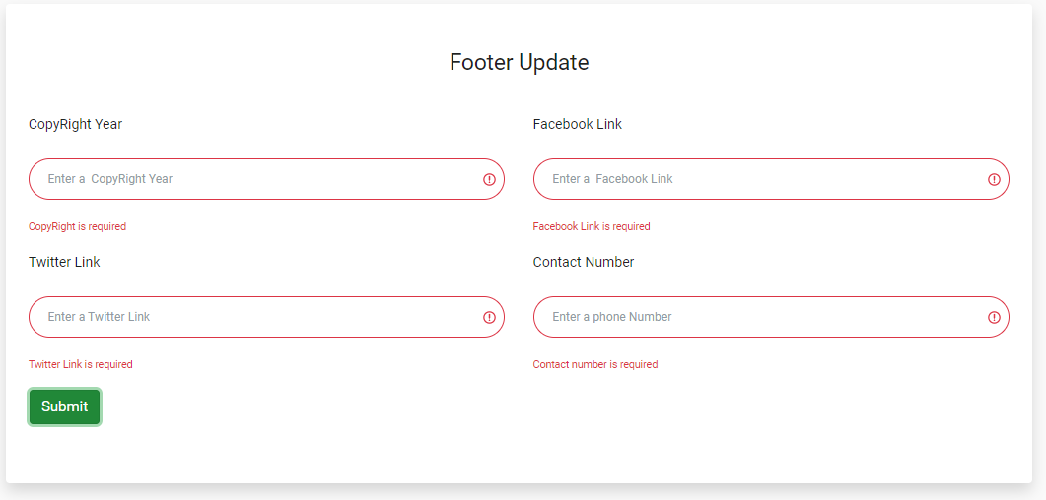
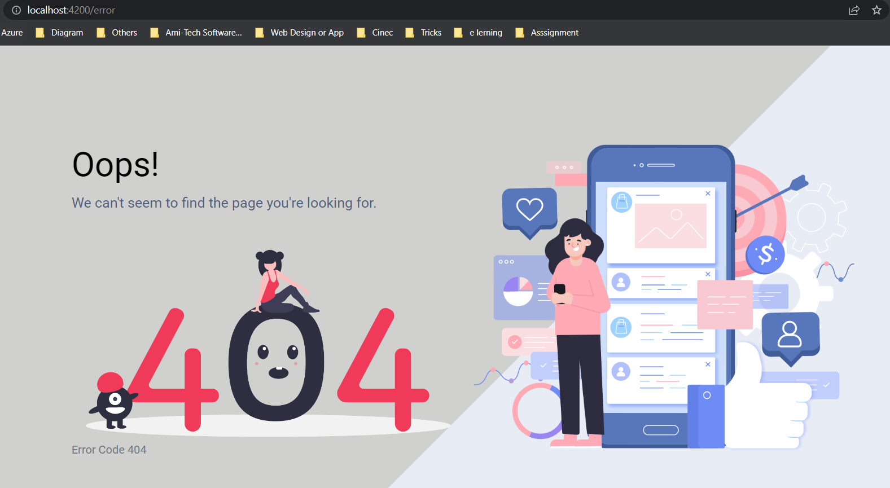
Project Progress – Test Case Cont.
Test Case | Description | Expected Result
03 | While fill the Footer update form if user did not fill the particular text box. | The form validation should give a error message
Test Case | Description | Expected Result
04 | If the user type wrong URL in the application | The error page need to show up
Output Result - Pass
Output Result - Pass

Slide 19
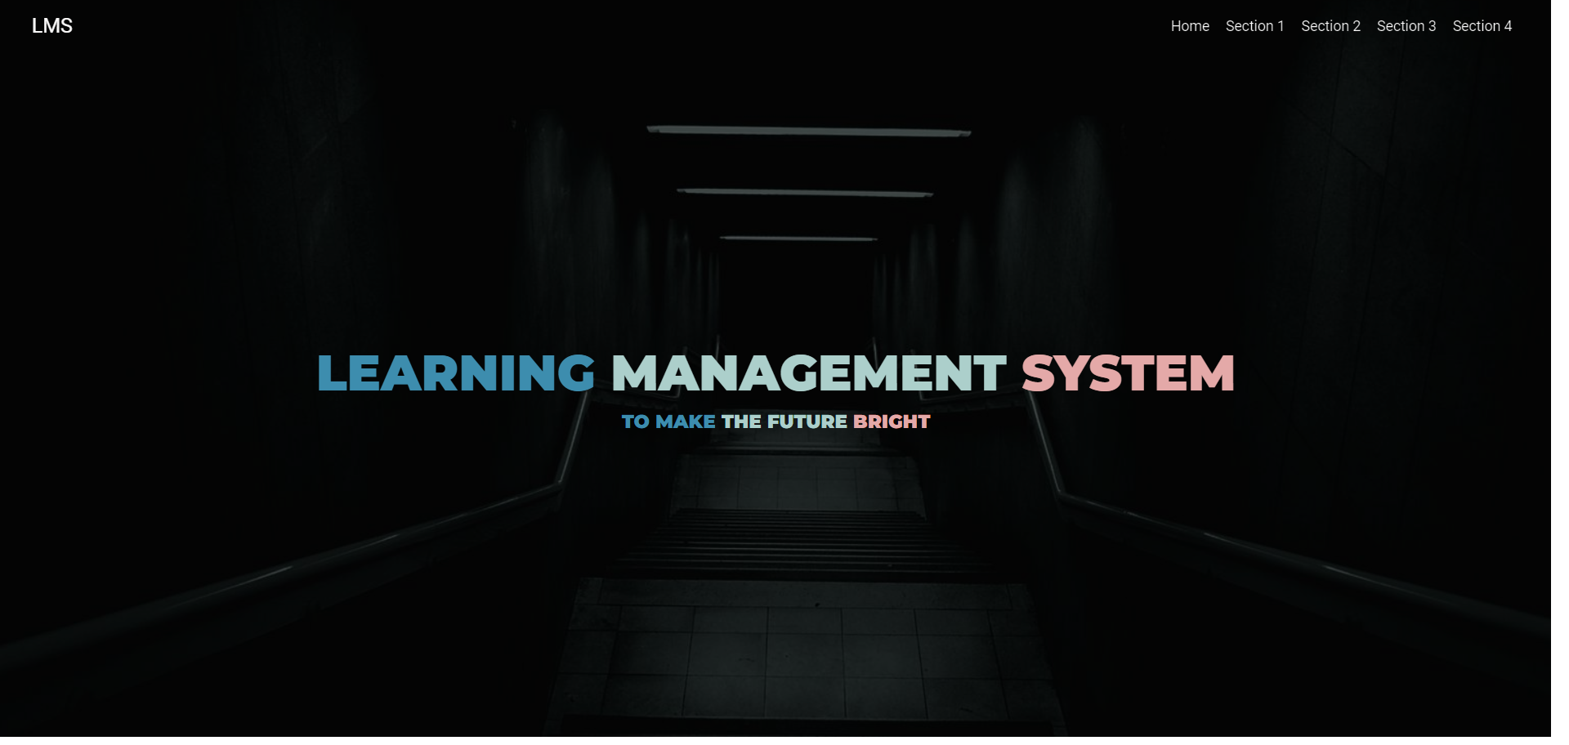

Project Progress (Prototype Screenshots)
User Frontend

Slide 20
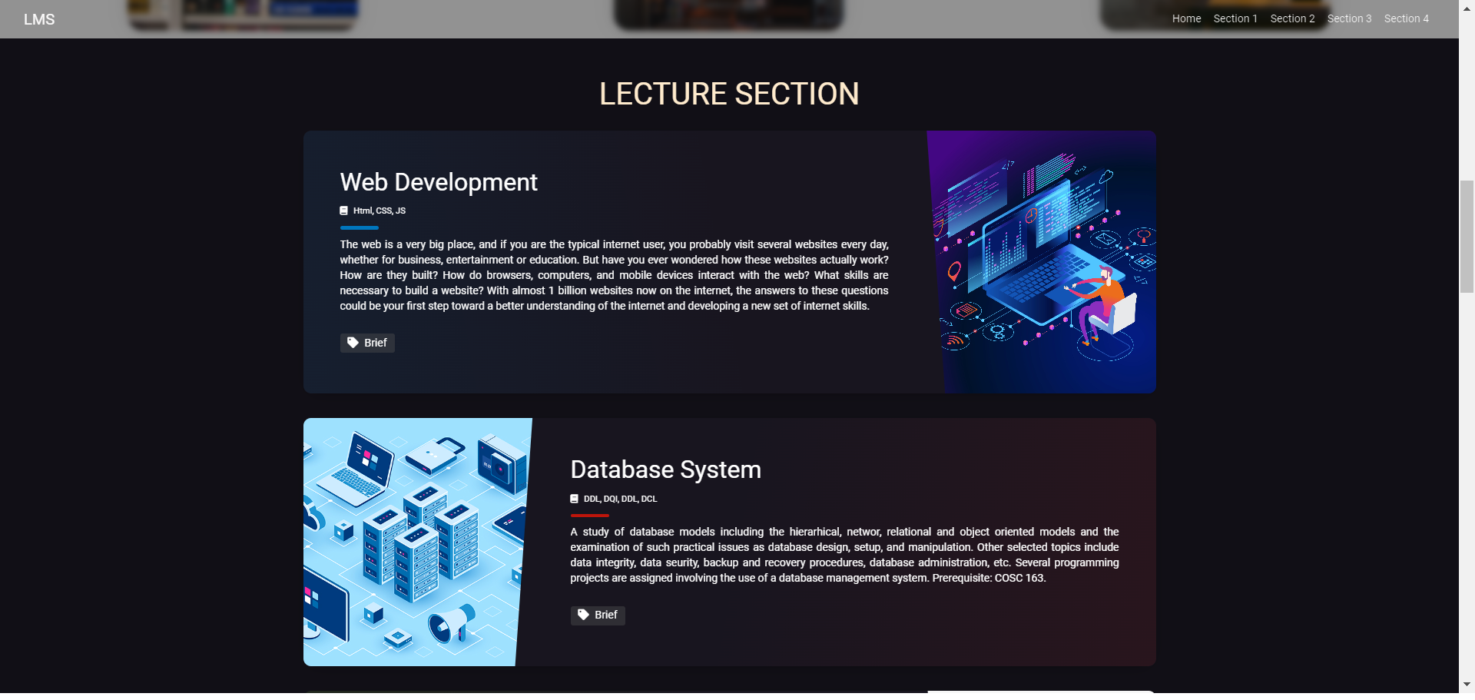
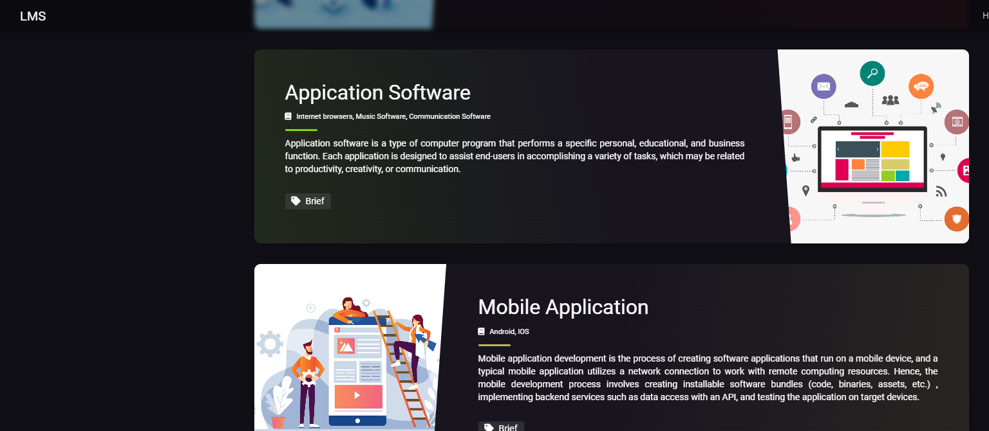
Project Progress (Prototype Screenshots)

Slide 21
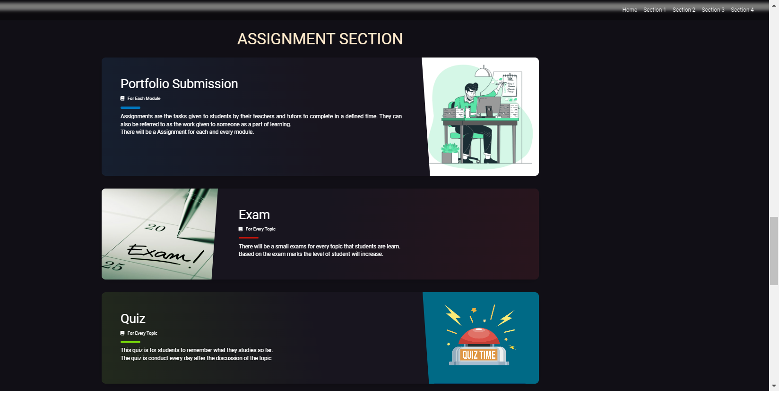
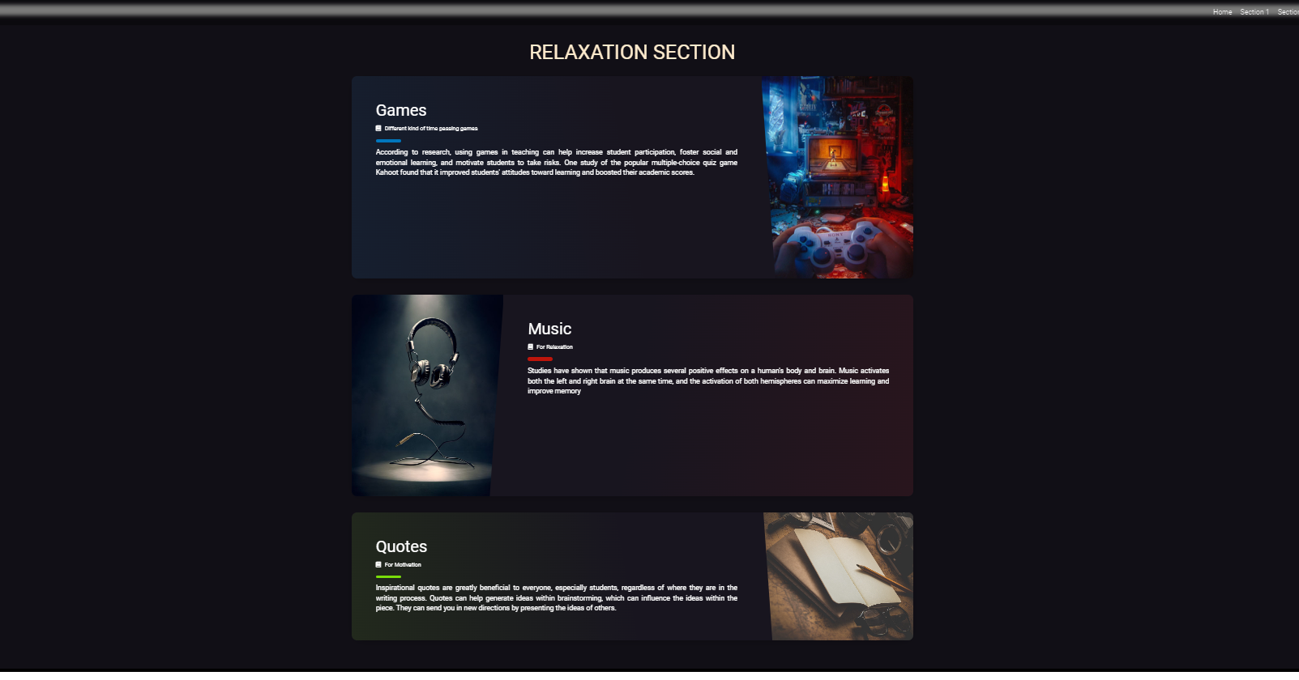
Project Progress (Prototype Screenshots)

Slide 22
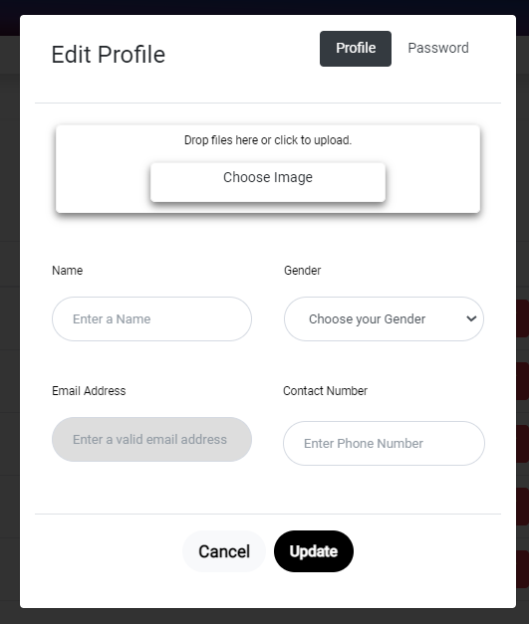
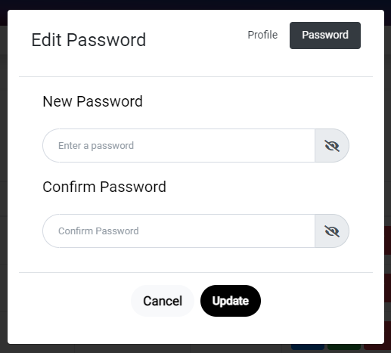
Project Progress (Prototype Screenshots)
Admin & Lecturer Frontend

Slide 23
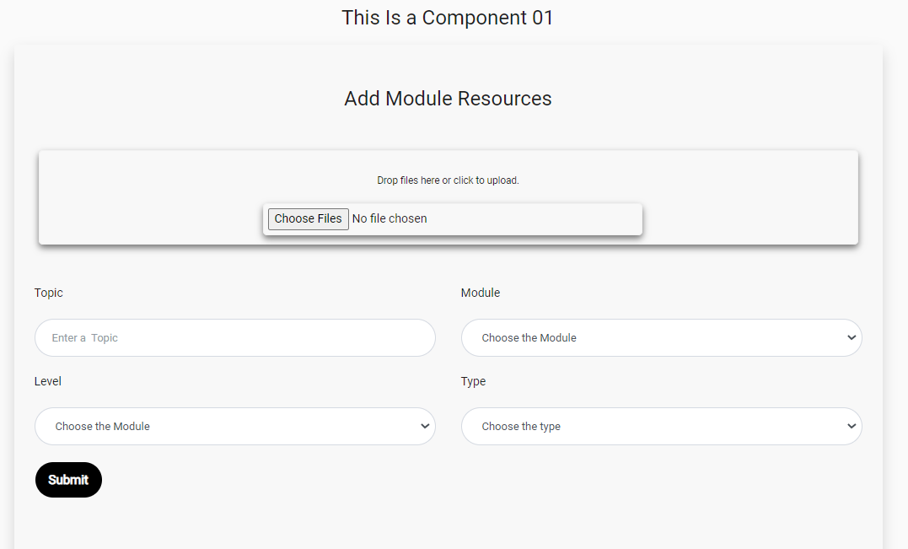
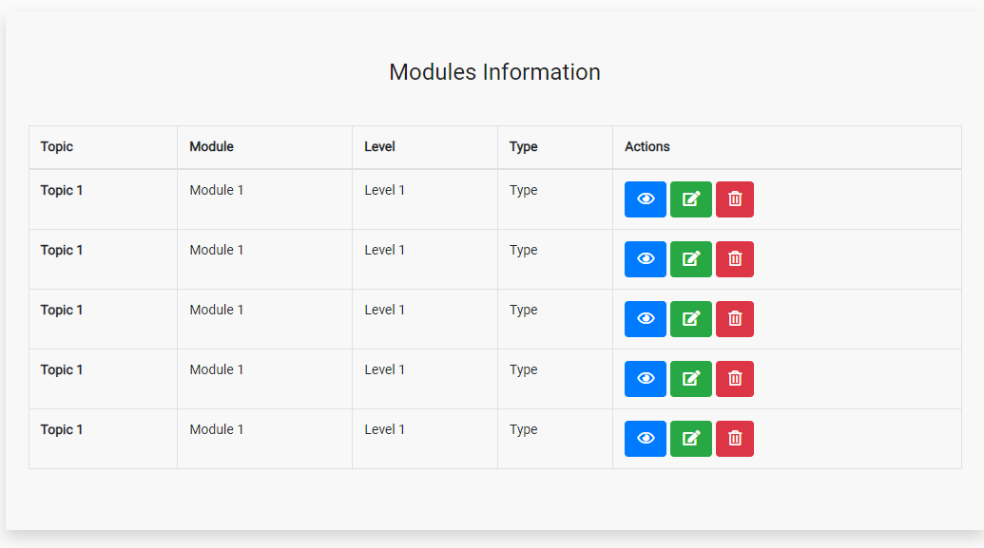
Project Progress (Prototype Screenshots)

Slide 24
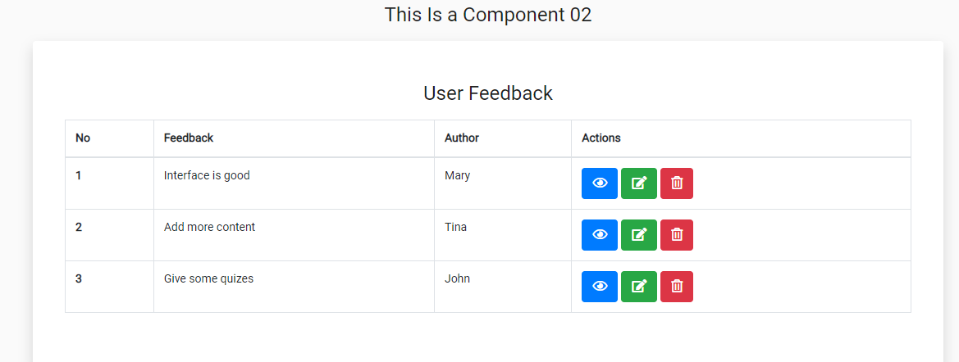
Project Progress (Prototype Screenshots)

Slide 25
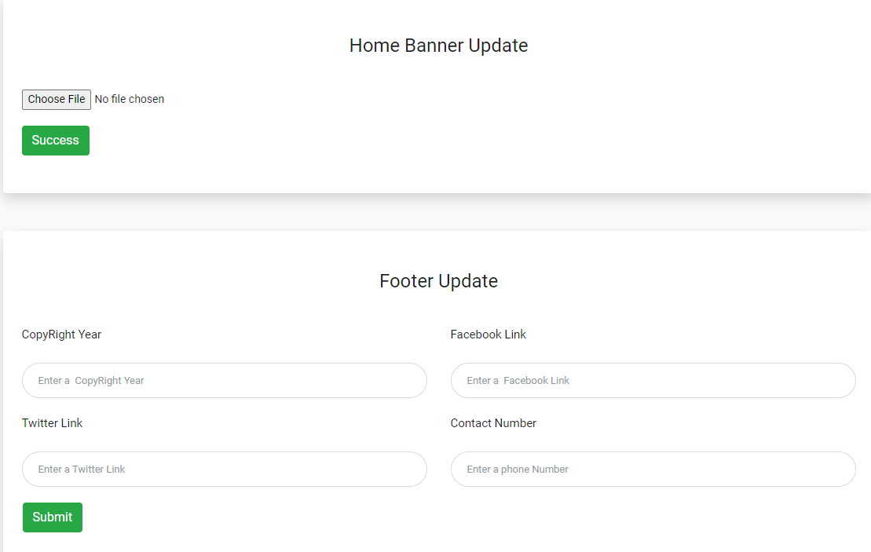
Project Progress (Prototype Screenshots)

Slide 26
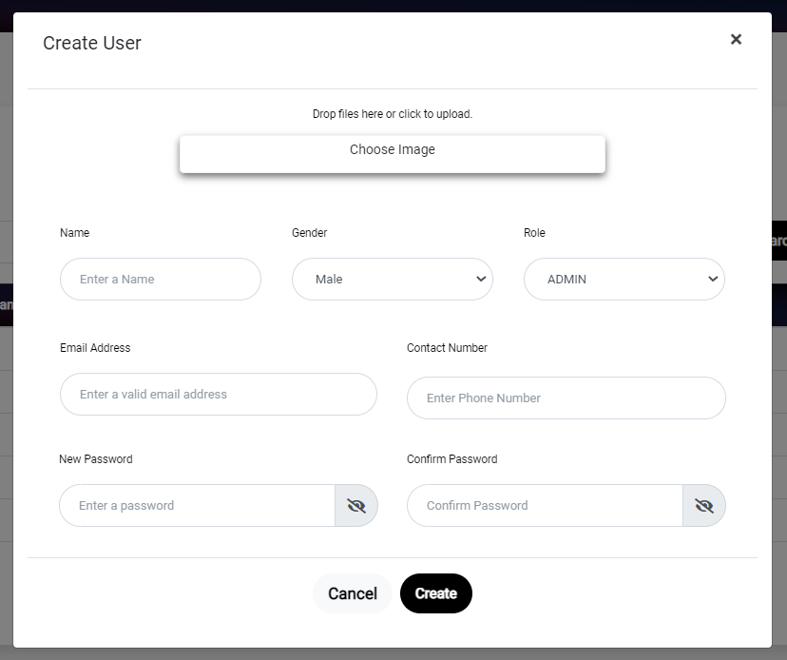
Project Progress (Prototype Screenshots)

Slide 27
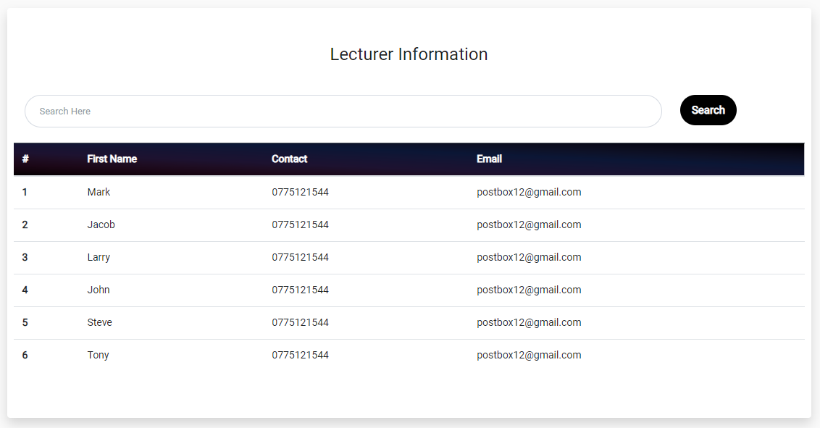
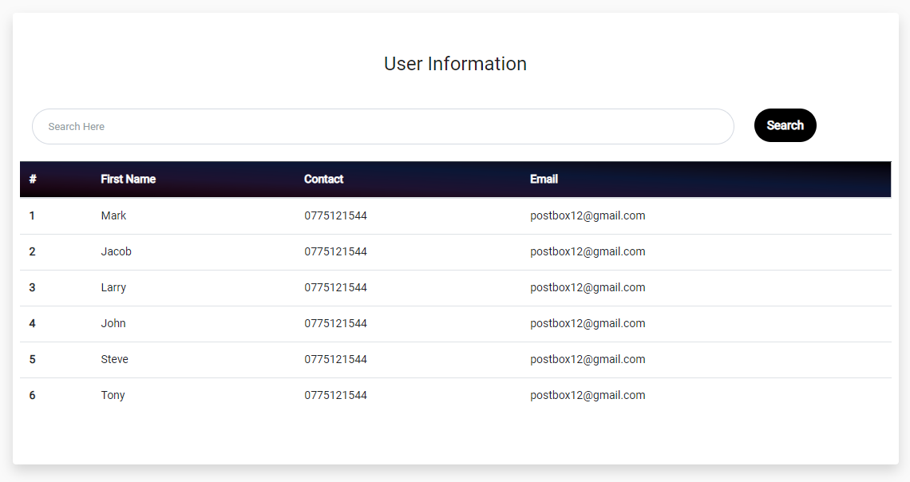
Project Progress (Prototype Screenshots)

Slide 28
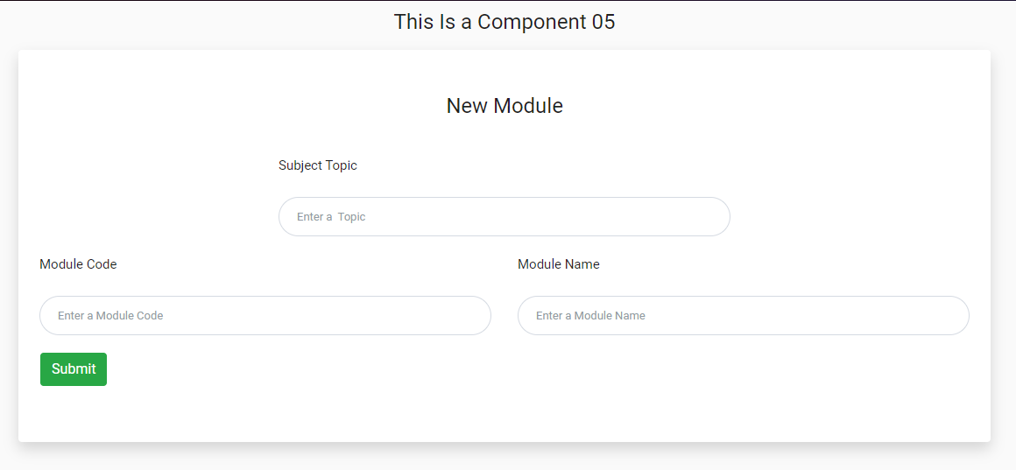
Project Progress (Prototype Screenshots)

Slide 29
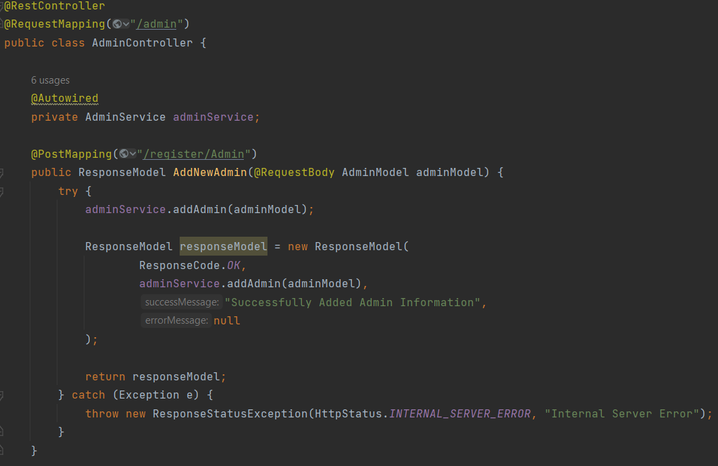
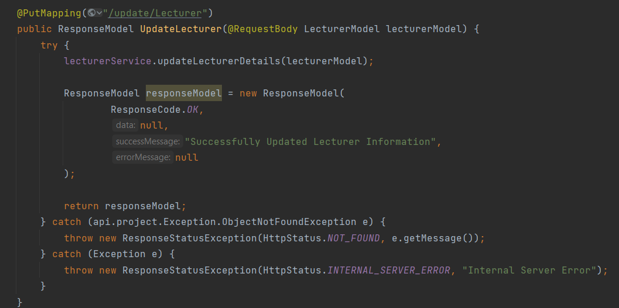
Project Progress (Prototype Screenshots)
Backend

Slide 30
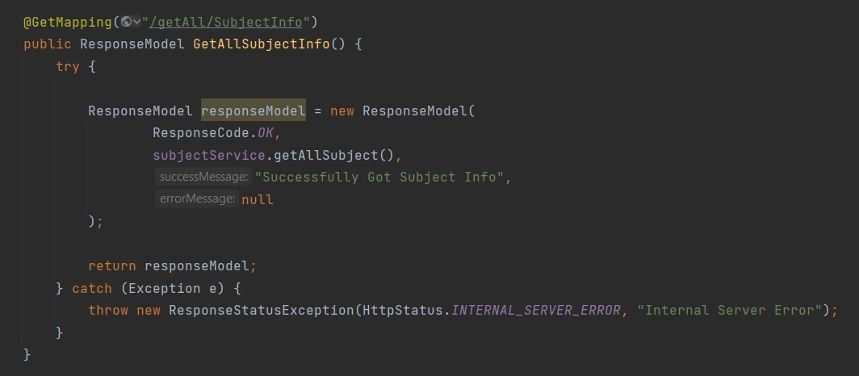
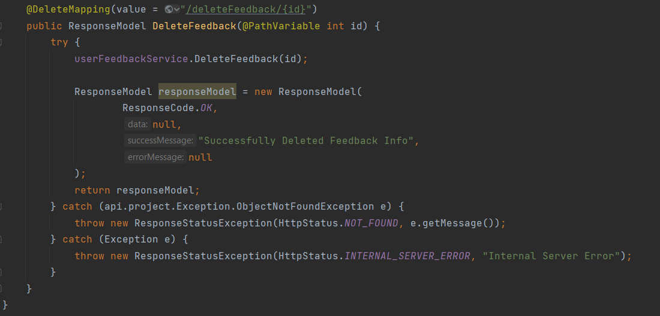
Project Progress (Prototype Screenshots)
Backend Cont.

Slide 31
Problems Identified and Solutions
Problem | Solution
How to add security system ? | Add Encryption & Decryption method with the key in Frontend and backend.
How to design more user-friendly? | Add Bootstrap CSS and Custom CSS to the friendly.
How to add games to system ? | Use extension to the angular framework for particular games in angular framework.
How to restrict the user control? | Add the user role to the local storage while login and according do that role restrict the permission.

Slide 32
Tools
Tool – Visual Studio Code, Xampp Server, IntelliJ
Front End – Angular
Backend – Spring boot

Slide 33
References
Getbootstrap. c2022. Forms Examples and usage guidelines for form control styles, layout options, and custom components for creating a wide variety of forms. [Online]. [2 July 2022]. Available from: https://getbootstrap.com/docs/4.0/components/forms/
Getbootstrap. c2022. Modal Use Bootstrap’s JavaScript modal plugin to add dialogs to your site for lightboxes, user notifications, or completely custom content. [Online]. [2 July 2022]. Available from: https://getbootstrap.com/docs/4.0/components/modal/
Getbootstrap. c2022. Buttons Use Bootstrap’s custom button styles for actions in forms, dialogs, and more with support for multiple sizes, states, and more. [Online]. [2 July 2022]. Available from: https://getbootstrap.com/docs/4.0/components/buttons/

Slide 34
Thank you !!!

